Slide 1

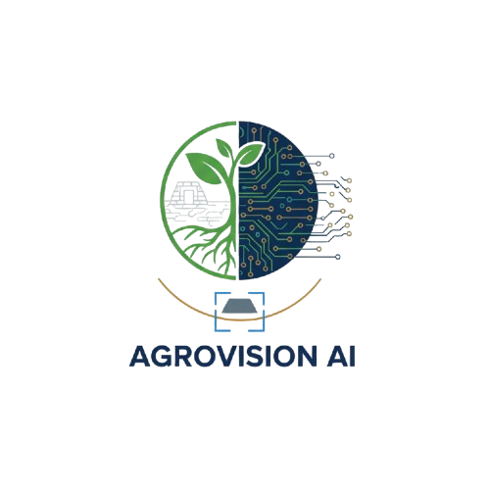
🌍AGROVISION AI
AI-Powered Smart Soil & Vegetation Analysis
Using Deep Learning for Ruins Detection, Vegetation Analysis & Erosion Prediction
1

Slide 2
PROBLEM STATEMENT
Agriculture plays a vital role in economic growth and food security. The quality of soil and the health of vegetation directly affect crop productivity and sustainability. Traditional methods of soil testing and vegetation assessment are manual, time-consuming, and expensive.
With the advancement of Artificial Intelligence and Computer Vision, image-based analysis has become an efficient alternative. AgroVision AI is designed to provide fast, accurate, and automated soil and vegetation analysis using deep learning models and image data.
2

Slide 3
OBJECTIVES
To identify different soil types using image-based analysis
To calculate vegetation and non-vegetation coverage accurately
To reduce dependency on manual soil testing
To provide a user-friendly and interactive dashboard
To support precision agriculture and smart decision-making
3

Slide 4
METHODLOGY
The methodology begins with collecting and preparing image datasets. Images are preprocessed through resizing, normalization, and augmentation to improve model performance.
For vegetation analysis, a DeepLabV3+ semantic segmentation model is trained to classify each pixel as vegetation or non-vegetation. This allows precise calculation of vegetation coverage percentage.
For soil detection, a YOLOv8 object detection model identifies soil regions and classifies them into soil types. The dominant soil is determined based on confidence scores, and coverage is calculated using bounding box areas.
Both models are integrated into a Streamlit dashboard, enabling real-time predictions through image uploads.
4

Slide 5
PROPOSED SOLUTION
AgroVision AI is a deep learning–based analytical platform designed to evaluate soil characteristics and vegetation patterns using satellite or land images. The system integrates powerful AI models with an interactive web dashboard to deliver instant insights.
It enables users to upload images and receive accurate predictions such as soil type, confidence score, vegetation percentage, and coverage area.
5

Slide 6


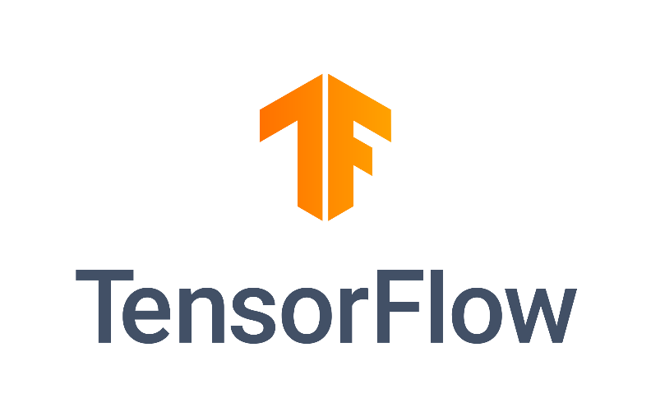


TECH STACK
Programming Language (Python):Primary Language used for Model Training,Inference,& Backend Logic.
AI & Deep Learning:
1.Semantic Segmentation-DeeplabV3+(Vegetation Analysis)
2.Object Detection- YOLOv8(Soil Detection)
Image Processing:
OpenCV:Used for image loading, format conversion, and display handling.
Frameworks & Libraries:
1.TensorFlow, Keras
2.PyTorch (Ultralytics YOLO)
6

Slide 7

TECH STACK
Web Application Framework: Streamlit (For Interactive AI Dashboard)
Frontend styling & UI:(CSS) Custom CSS Used to create a Professional & User Friendly Dashboard (Embedded in Streamlit).
Model Format:
1.Tenserflow SaveModel/Keras Used for Vegetation model.
2.YOLO.pt format Used For Soil Detection model.
Deployment & Version Control:
1.Git & github Used for version control and Project Collaboration
2.Streamlit Cloud/ Render used to host web Application & make it accessible Online.
Development Environment: Vscode and Google Colab.
7

Slide 8
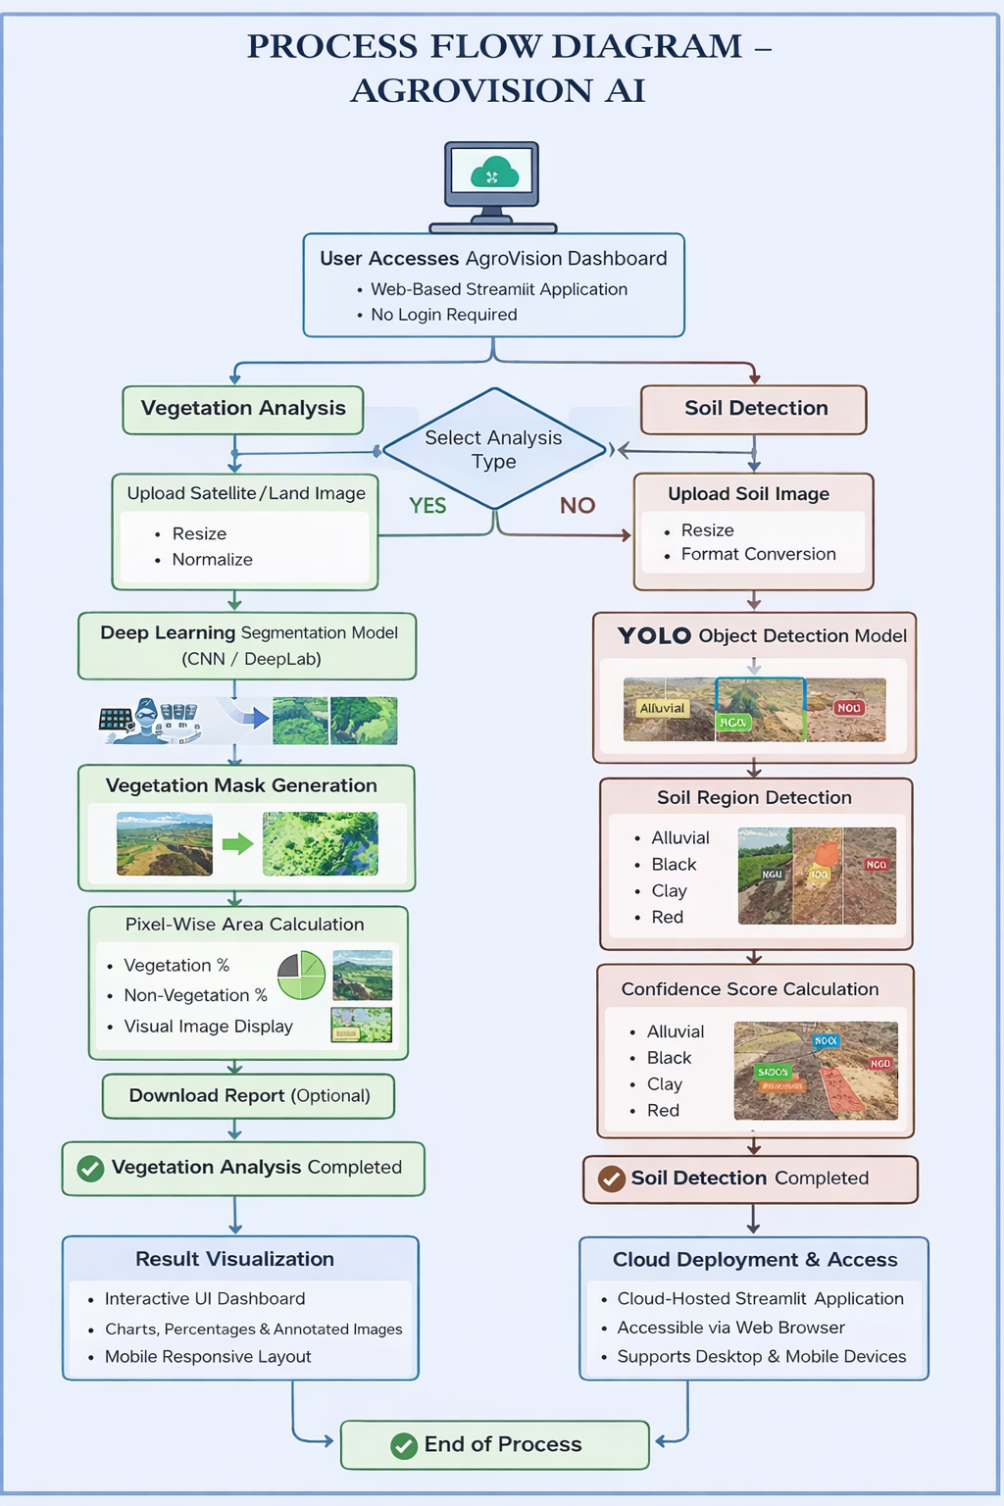
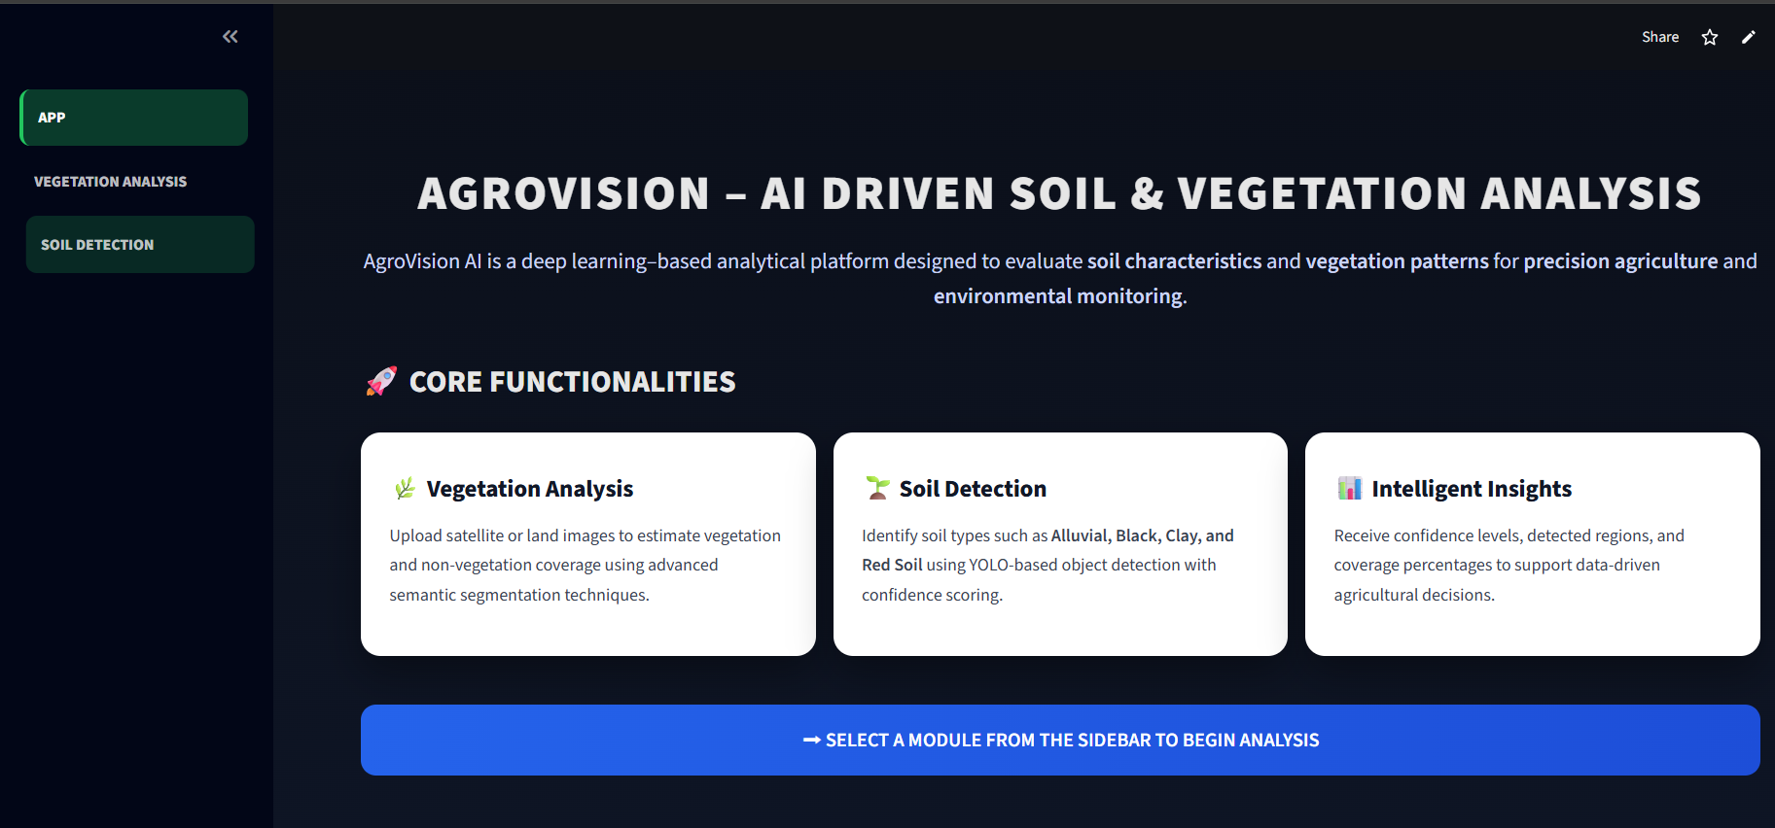
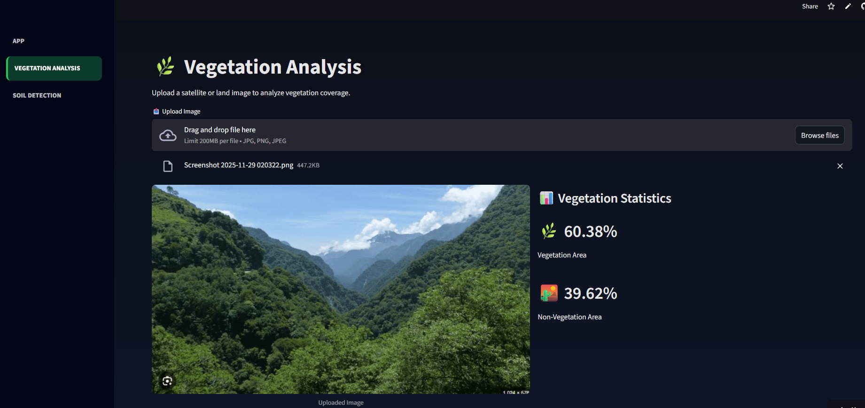
USER INTERFACE PREVIEW
8

Slide 9
RESULT
Vegetation Analysis (Semantic Segmentation – DeepLabV3+)
The vegetation analysis model accurately separates vegetation and non-vegetation regions from land & satellite images.
The model performance was evaluated using standard segmentation metrics:
Pixel Accuracy: ~92–95%
Intersection over Union (IoU): ~0.85
Dice Coefficient (F1 Score): ~0.90
The model produces:
Binary vegetation masks
Accurate vegetation coverage percentage
Clear visual segmentation results
The results show high consistency and reliability across different terrain images.
9

Slide 10
RESULT
Soil Detection (Object Detection – YOLOv8)
The soil detection model successfully identifies and classifies multiple soil types:
Alluvial Soil,Black Soil,Clay Soil,Red Soil.
The model was evaluated using object detection metrics:
Overall Detection Accuracy: ~88–92%
Mean Average Precision (mAP@0.5): ~0.86
Confidence Score Range: 0.75 – 0.95
The model provides:
Bounding boxes for detected soil regions
Dominant soil type identification
Soil coverage percentage for each image
The results demonstrate robust performance across different soil textures and lighting conditions.
10

Slide 11
CONCLUSION
AgroVision AI successfully demonstrates the use of deep learning for automated soil and vegetation analysis using images. The system accurately identifies soil types and estimates vegetation coverage, reducing the need for manual field inspections. With reliable performance, clear visual outputs, and a user-friendly dashboard, AgroVision AI provides an efficient solution for precision agriculture and data-driven land assessment. The project highlights how AI can support smarter agricultural planning and environmental monitoring.
Github Repo: https://github.com/Vedantpatil03/AgroVision-AI.git
Live Website: https://agrovision-ai.streamlit.app/
11

